Slide 1
Orchestration
Model
Discovery
References
Resources

Slide 2
Service Discovery
In code
Named endpoints
By reference

Slide 3




Microservices
Cloud Services
Identity Service
Client Apps
Identity API
Mobile App
Mobile API
Catalog Service
Catalog API
Ordering Service
Event Bus
Browser
Ordering API
Web App
Order processor
Basket Service
Basket API
Admin Services
Webhook Client
Observability
Webhooks API

Slide 4
SOA
Cloud Services
Customer
Client Apps
Mobile App
Mobile API
Order
Service Bus
Payment
Browser
Web App
Reporting
Data

Slide 5
Modular Monolith
App hosting
App
Customer
Client Apps
Mobile App
Mobile API
Order
Payment
Browser
Web App
Reporting
Data

Slide 6
Monolithic server process
Modules
Data
Customer
Client Apps
Mobile App
Mobile API
Order
Payment
Browser
Web App
Relational database
Identity
Catalog

Slide 7
Server-based
Server
Client Apps
App
Customer
Order
Payment
Reporting
Data
Mobile App
Browser
App
Customer
Order
Payment
Reporting
Data

Slide 8
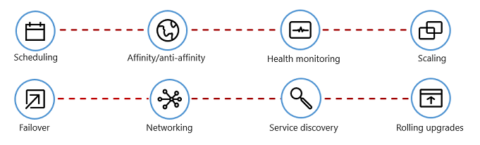
Scheduling
Affinity
Health monitoring
Scaling
Failover
Networking
Service discovery
Rolling upgrades

Slide 9


Migrate
Modernize
Containerize
Existing apps & services .NET Framework on-premises
Rehost
Cloud Infrastructure Ready apps
Cloud Optimized apps
Cloud-Native apps
Rearchitect & Rebuild
On-Premises Infrastructure Platform
IaaS Lift & shift
Containers & PaaS
Microservices & Serverless
No code changes
Rewrite

Slide 10
Containers
Backing Services
Microservices
Cloud-Native App
Automation
Modern Design

Slide 11

Host Machine
Product:1.0
Basket:2.0
Product:2.0
Product:API v1.1
Basket:API v4
Product:API v2
Lib-L v2
Lib-L v3.1
Lib-L v3
Lib-M v9
Runtime v5
Runtime v7
Runtime v6
Host OS

Slide 12
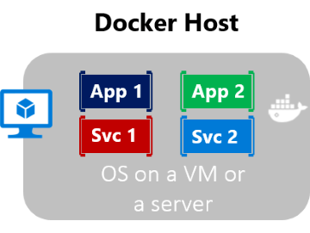
Docker Host
App 1
App 2
Service 1
Service 2

Slide 13



VM 1
VM 2
App1
App2
Bins/Libs
Bins/Libs
Guest OS
Guest OS
Hypervisor
Host OS
Infrastructure

Slide 14
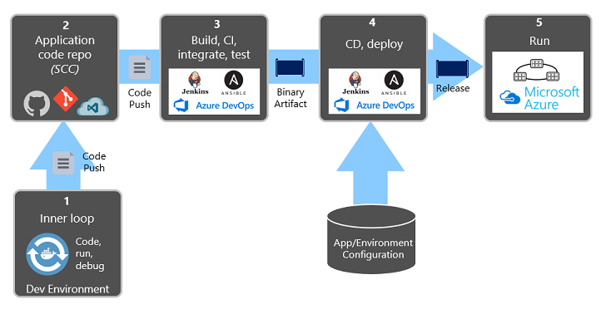


Code, run, debug
Dev Environment
1
Code Repo
2
Build, CI, integrate, test
3
CD & deploy
4
Run
5
Push
Push
Binary
Release
App/Environment Configuration

Slide 15
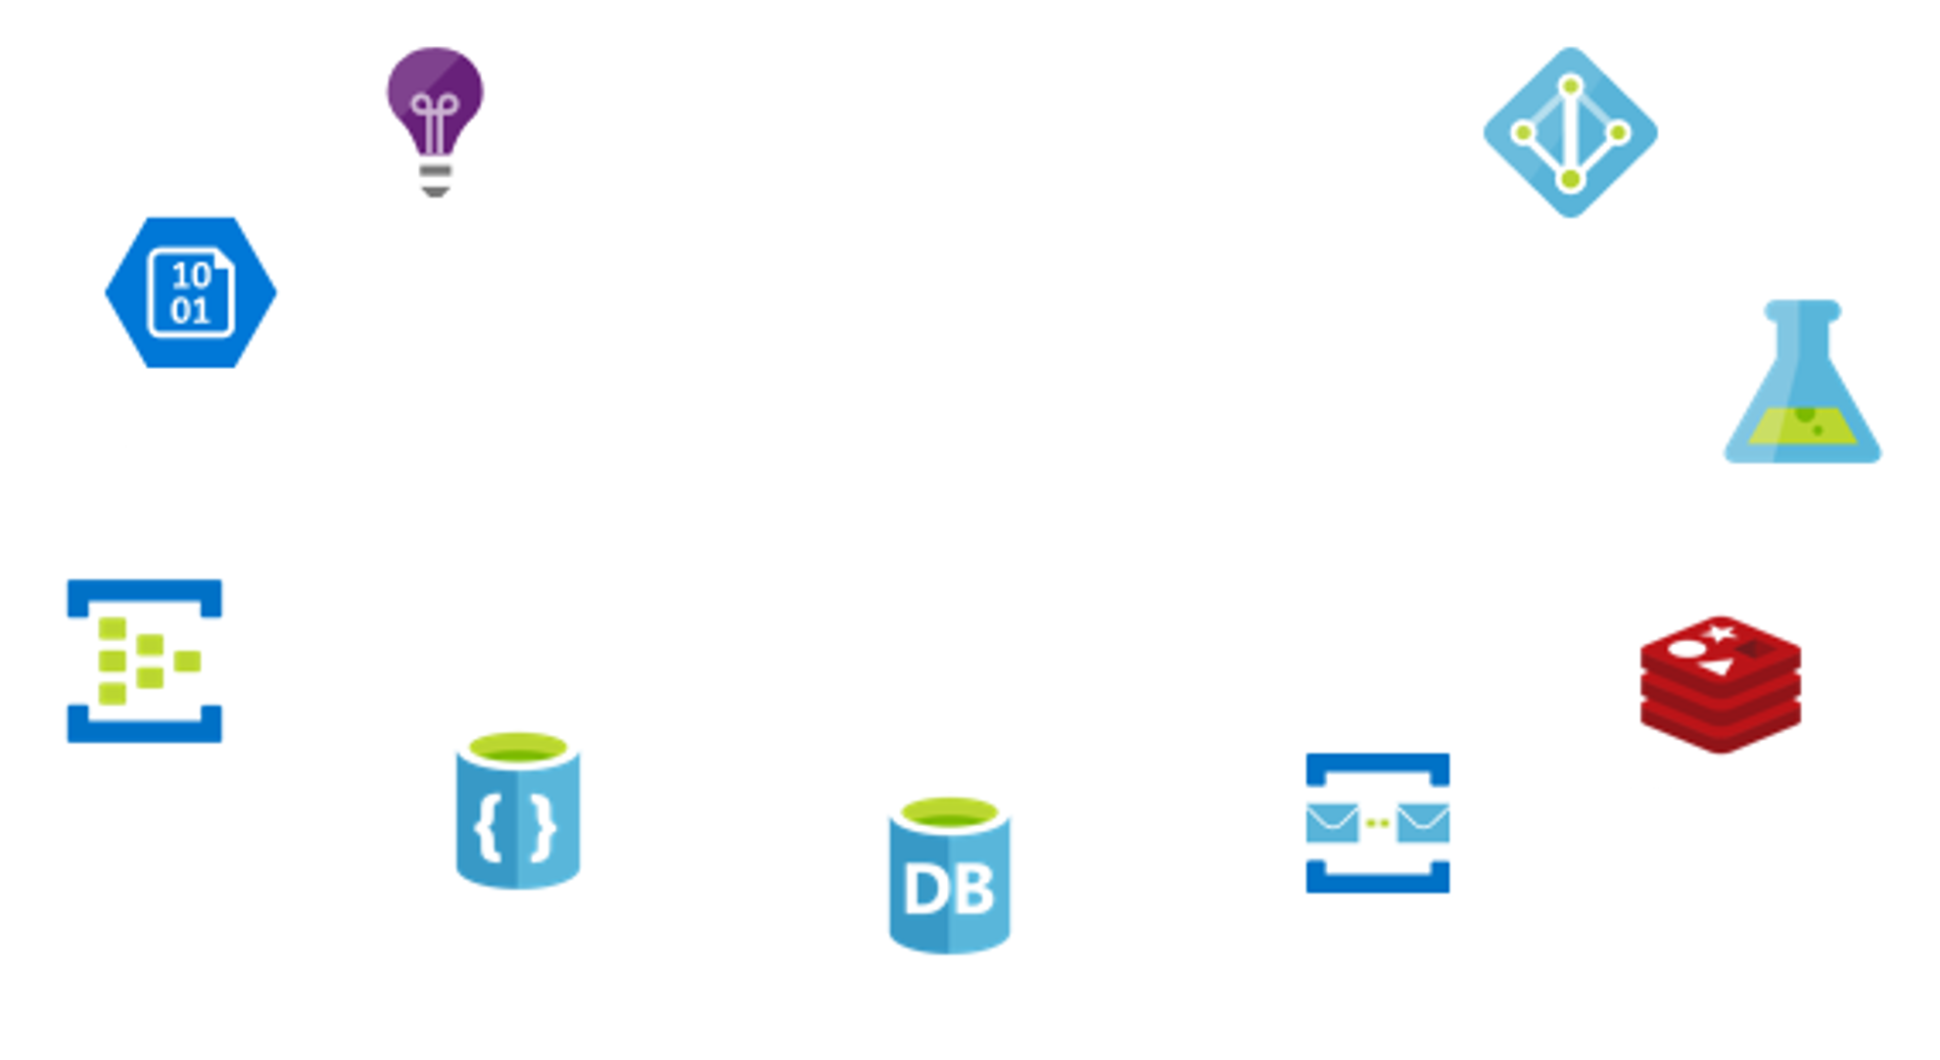
Monitoring
Security
Storage
Analytics
Cloud-Native System
Streaming
Caching
NoSQL
Messages
Relational

Slide 16
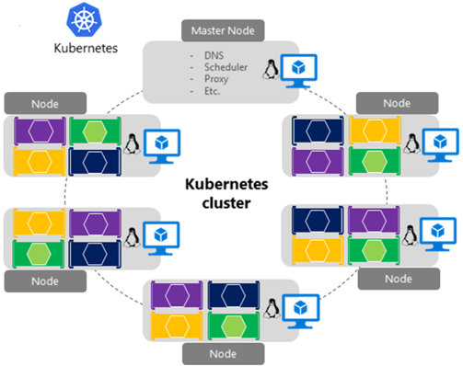

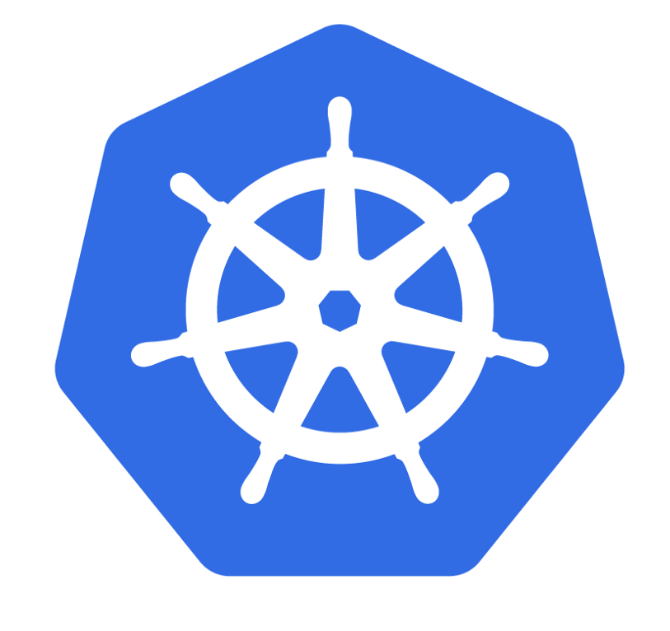
Master Node
- DNS - Scheduler - Proxy
Node
Node
Kubernetes
cluster
Node
Node

Slide 17
Microservice
Microservice
Sidecar Proxy
gRPC
Sidecar Proxy
HTTP
HTTP
Microservice
Microservice
Microservice
gRPC
HTTP
Sidecar Proxy
Sidecar Proxy
Sidecar Proxy
gRPC
gRPC
Microservice
Microservice
Sidecar Proxy
HTTP
Sidecar Proxy

Slide 18
Control Plane
C#
Java
Golang
Microservice
Microservice
Microservice
Sidecar Proxy
HTTP
Sidecar Proxy
gRPC
Sidecar Proxy
Data plane

Slide 19
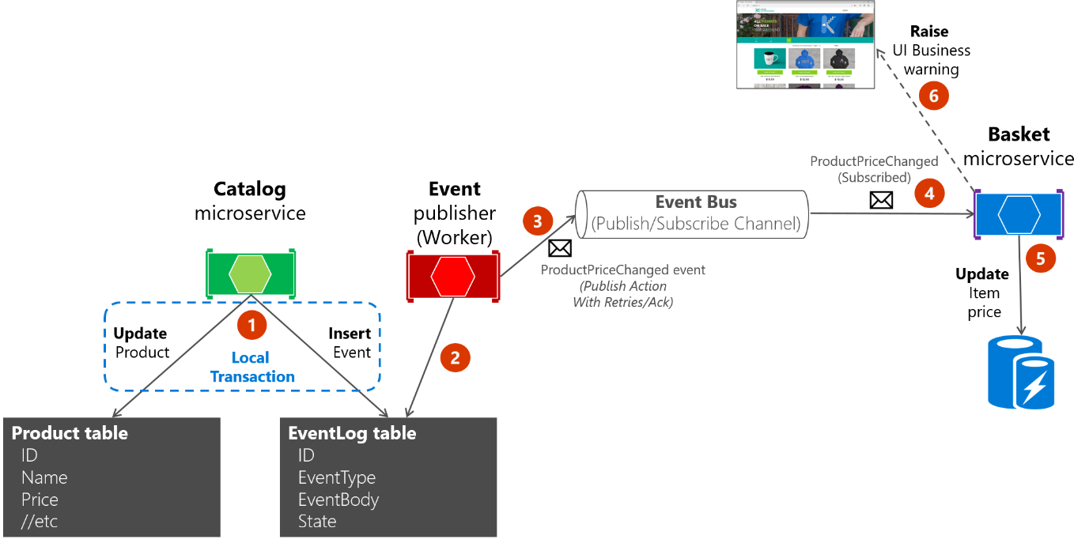

Slide 20


Shared Services
Microservice
Service
Single shared relational database
Microservice
Service
Microservice
Service
Monolithic
Cloud Native

Slide 21
Catalog Service
Catalog API
Ordering Service
API Gateway
Ordering API
Order processor
Basket Service
Basket API

